Slide 1

GitHub Metered Billing

Slide 2
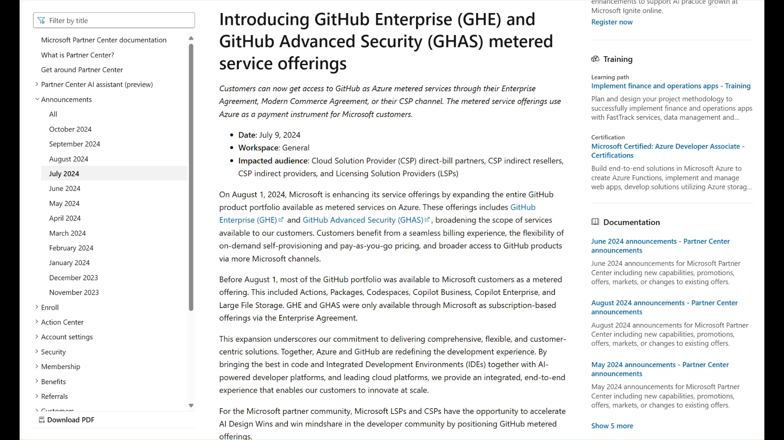

Slide 3
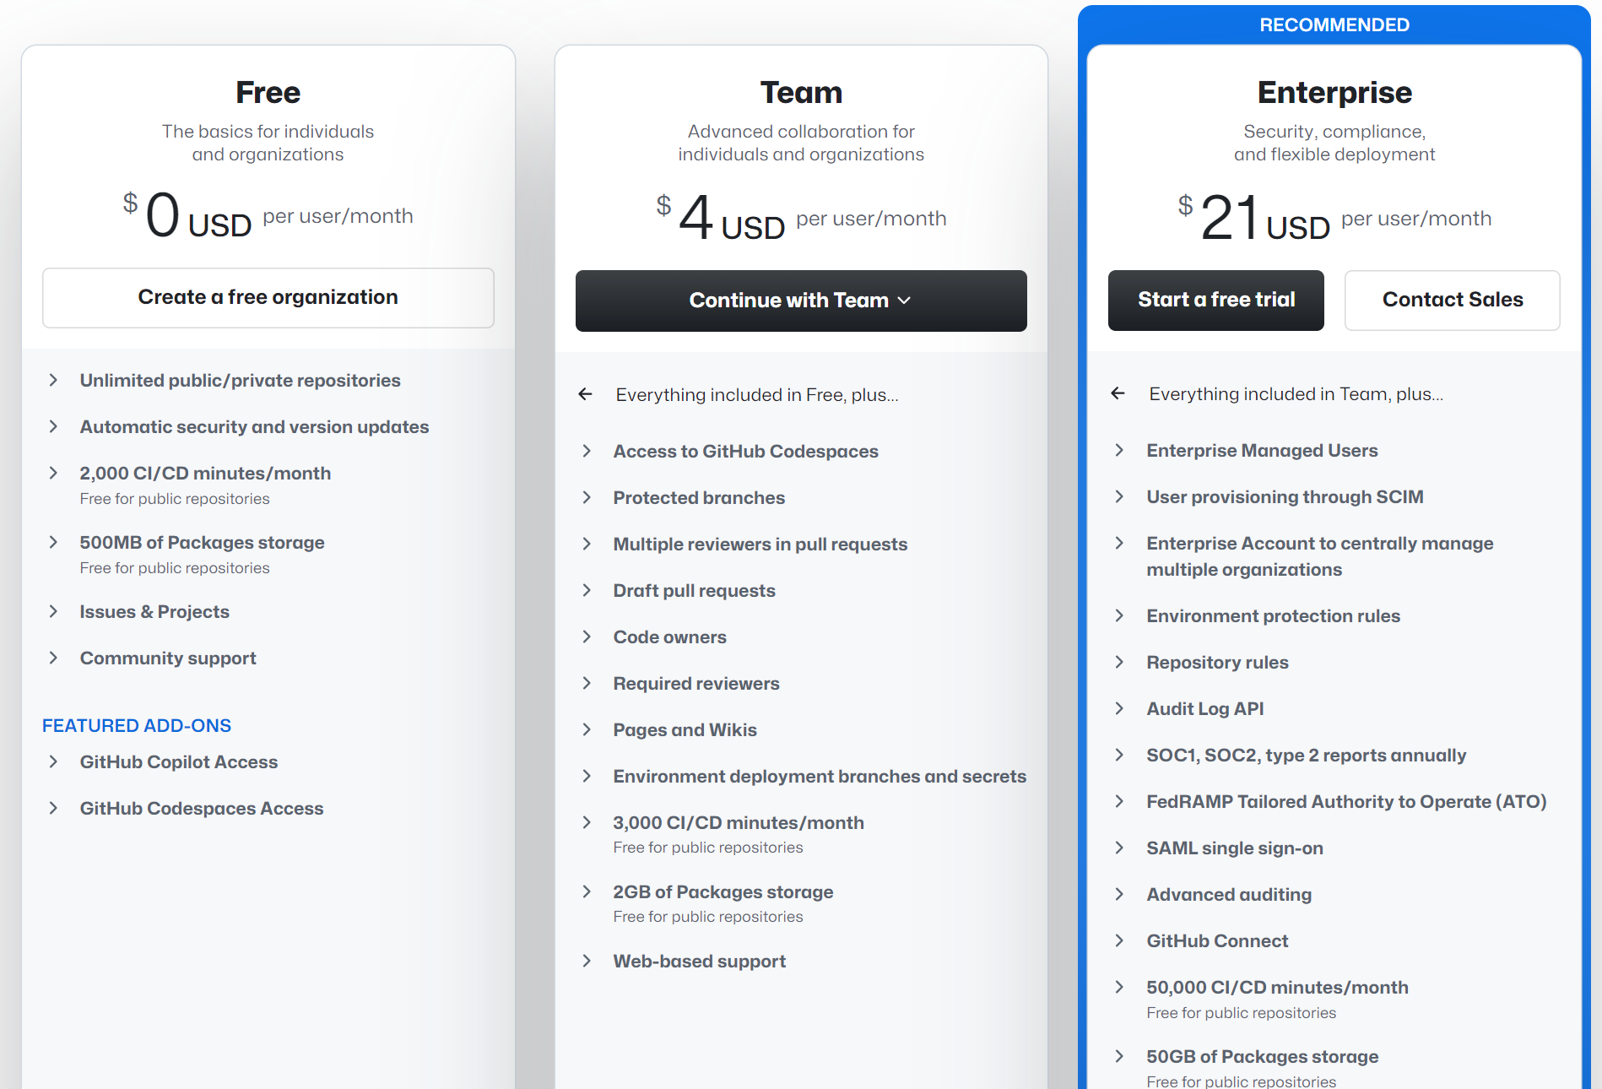

Slide 4


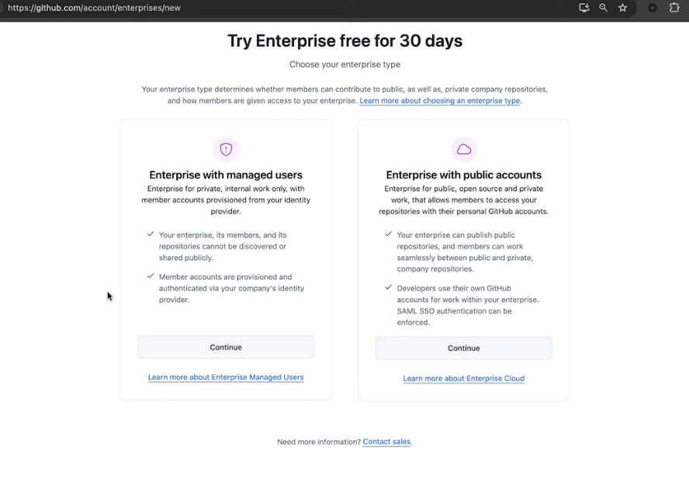



GitHub services now available on Azure Meter
Consistency
Experience frictionless procurement and billing across your entire GitHub and Azure portfolio.
Flexibility
Flexibly adjust and provision licensed seats as your organization evolves, paying only for what you need.
Versatility
Acquire GitHub seamlessly—whether through GitHub’s familiar channels or Microsoft’s trusted routes.

Slide 5

Managing effectively
Key requirements for success
Avoid tool sprawl and spur collaboration
Developers
Streamline onboarding
Standardize tool usage
Accelerate common tasks
Stay in the flow, eliminate the need for context switching
Managers
Empower project customization
Create security, compliance, governance success
Reduce licensing, support, and operating costs

Slide 6






Better Together
Manage effectively
GitHub Enterprise Cloud
Azure Portal
Modern, collaborative, secure DevOps
Build, manage, and monitor everything
Access to the entire GitHub portfolio
Centralized app management
A fully integrated platform from idea-to-production
DevOps platform and AI tools
Unified
cloud management
Customizable dashboards
Collaborative, automated workflows
Fine-grained access control
Developer-focused security and compliance
3,000+ 1st- and 3rd-party services

Slide 7
Azure Metered for GitHub Products
GHE and GHAS will now qualify for Microsoft Azure Consumption Commitment (MACC), Monetary Commit (MC), Azure Credit Offers (ACO) and Azure Committed Revenue (ACR) when Metered billing is selected.
Overview
Important Consideration
Products | ACR MACC | Prepay ACO | ACD SKU Discount
Actions hosted runners | 🟢 | 🟢 | 🟢
Actions large hosted runners | 🟢 | 🟢 | 🟢
GitHub Packages | 🟢 | 🟢 | 🟢
GitHub Storage | 🟢 | 🟢 | 🟢
Codespaces | 🟢 | 🟢 | 🟢
GitHub Copilot （include both Business and Enterprise） | 🟢 | 🟢 | 🟢
GitHub Enterprise Cloud (GHEC) | 🟢 | 🟢 | 🟢
GitHub Advanced Security (GHAS) | 🟢 | 🟢 | 🟢
GHAS for Azure DevOps (GHAzDO) | 🟢 | 🟢 | 🟢
Billing via Azure for GHE/GHAS services
Self-provisioning for customers to convert trial to paid
Licensing Type Transition Support to help customer make the update
Enhanced Billing Experience with enhanced capabilities
GHAS Enablement & Trial Experience synced between GHE and GHAS

Slide 8







GitHub Purchasing Paths by Product
Billed License through EA
Azure Metered as a “Seats”​
Azure Metered ​by resources consumption​
Visual Studio Subscription +GitHub Enterprise Bundle License
GitHub Copilot Business
$19 /user/month
GitHub Copilot Enterprise
$39 /user/month
GitHub Actions+ Larger hosted runners
e.g. $0.008 /2 cores/min
GitHub Enterprise License
GitHub Codespaces
e.g. $0.18 /2 cores/hour
GitHub Enterprise Metered
$21 /user/month
GitHub Advanced Security License
GitHub Advanced Security Metered
$49 /committer/month
GitHub Packages
e.g. $0.008 /day/GB

Slide 9
Billing Cycle
GitHub Enterprise / GitHub Copilot Metered
New user assigned in the mid month will be prorated
Any user removed mid month will be charged for the full month, and no longer be charged for future months
e.g. Adding a new user on 17 Oct, even removing the user on 20 Oct, 17-31 Oct will be charged
GitHub Advanced Security Metered
Counts the committer who has committed code in last 90 days
If the user’s first commit is in mid month, the first month will be prorated
The 90-day window resets on each commit, same as non-metered model
If GitHub Advanced Security is disabled on a repo, invoicing is stopped, the 90-day window does not count as the repo is no longer secured
About billing for GitHub Advanced Security - GitHub Enterprise Cloud Docs

Slide 10
GitHub Product recommendation
Recommended
Product | GitHub Enterprise + GitHub Copilot Business | GitHub Enterprise + GitHub Copilot Enterprise | GitHub Enterprise GitHub Copilot Enterprise GitHub Advanced security
Scenario | Customers want to use GitHub enterprise and GitHub copilot to unlock full capabilities. | Customers have their own unique code. And want to fine tune those codes all over again for better copilot generation. | Enhanced software supply chain security, customers want to leverage full-stack capabilities and incorporate AI.
Monthly ACR per user | $40 | $60 | $109
Features​ Difference | Code Review​ Pull requests​ Protected branches​ Repository Insights​ Auto review assign​ Private repo​ Issues, Projects, Milestones​ Discussion | Fine-tuned models​ Custom chat to your repo​ Answers from your KB​ Top open-source repo insights​ Pull request diff analysis​ Pull request summaries | Code scanning​ Secret scanning​ Dependency review​ CodeQL CLI​ Custom auto-triage rules
Benefits | Ent-level management​ Auditable and measurable​ Private and protection | Customize GitHub Copilot​ Infuse AI across the developer workflow. | Improve code quality​ Reduce vulnerabilities​ Enhance supply chain

Slide 11
Existing Customer for transitioning to metered
Eligible
Not Eligible
Cloud First Customer –mostly on GitHub Enterprise cloud
For Hybrid deployment ( GHEC + GHES ) - Only customers with GitHub Connect enabled and GHES version 3.13 or above are eligible
Visual Studio + GitHub Enterprise bundle customers are not supported
Customer only using GHES (GitHub Enterprise Server) and no plans to move to GHEC ( GitHub Enterprise Cloud )
Additional Considerations:​
Customers are eligible to transition during ON TIME renewal
Metered billing is a 'Cloud First' experience ​

Slide 12
Sample Scenarios
 | Currently Owns | Customer Wants | Supported
Scenario 1 | GitHub Enterprise Subscription (no GitHub Advanced Security) | GitHub Advanced Security Metered | Yes - GitHub Connect required
Scenario 2 | GitHub Enterprise & GitHub Advanced Security Subscription | GitHub Advanced Security Metered | Yes - at time of renewal, a customer can retain GitHub Enterprise subscription while transitioning to GitHub Advanced Security metered. GitHub Connect required.
Scenario 3 | GitHub Enterprise Subscription | GitHub Enterprise Subscription & GitHub Enterprise Metered | No, a customer cannot have both GitHub Enterprise metered and GitHub Enterprise subscription.
Scenario 4 | GitHub Enterprise Subscription | GitHub Enterprise Metered Only | Yes, but must migrate to metered at renewal and assign all users to the cloud
Scenario 5 | GitHub Enterprise Metered | GitHub Advanced Security Metered | Yes
Scenario 6 | GitHub Enterprise Metered | GitHub Advanced Security Subscription | No, GitHub Enterprise metered requires GitHub Advanced Security metered

Slide 13
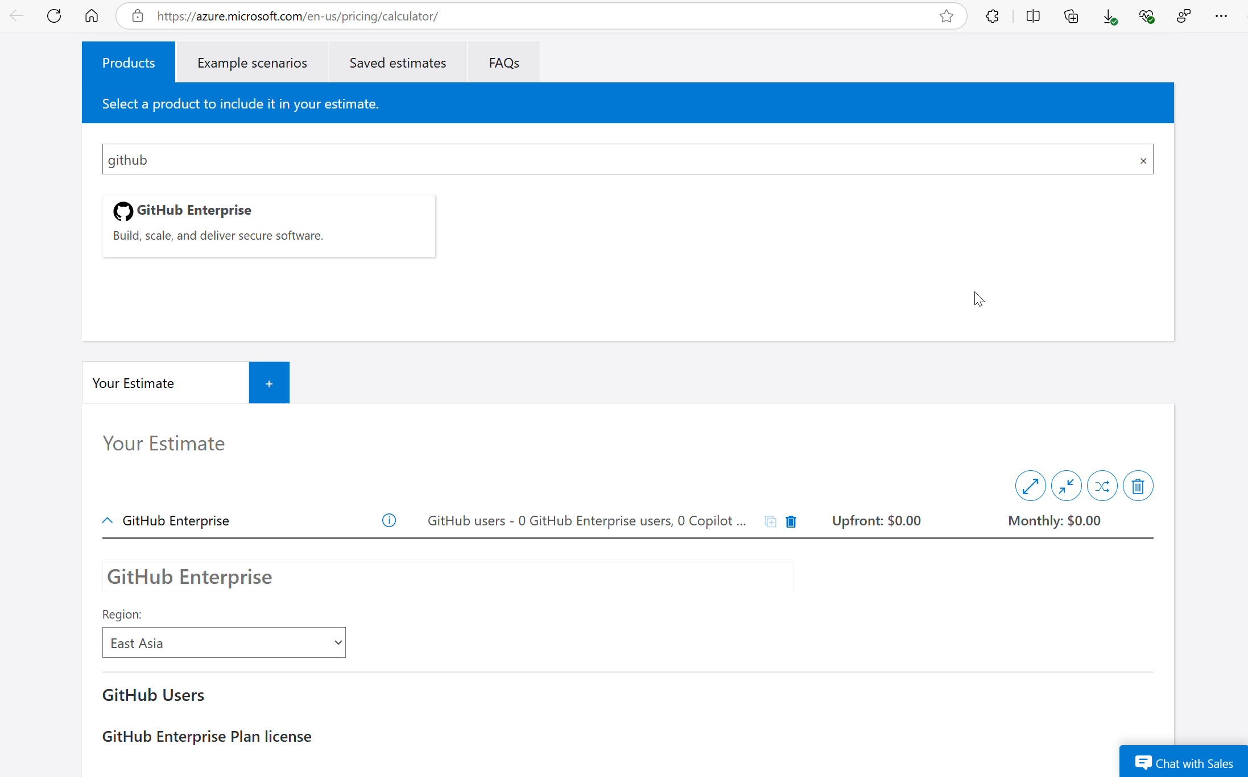
Cost Estimation with Azure Pricing Calculator
Pricing Calculator | Microsoft Azure

Slide 14
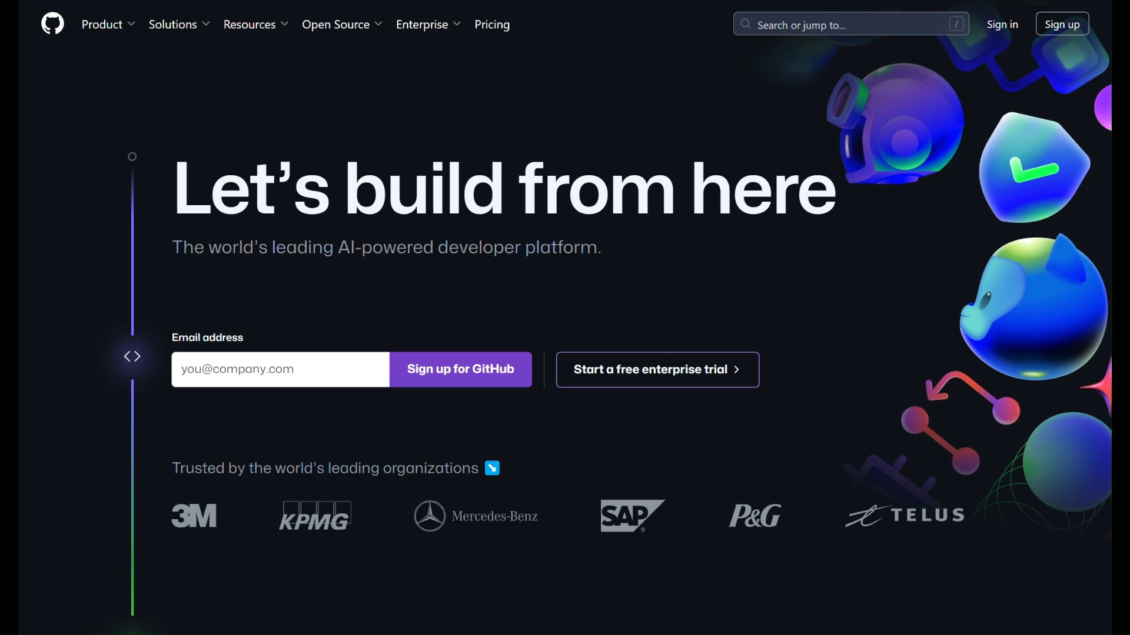

Slide 15
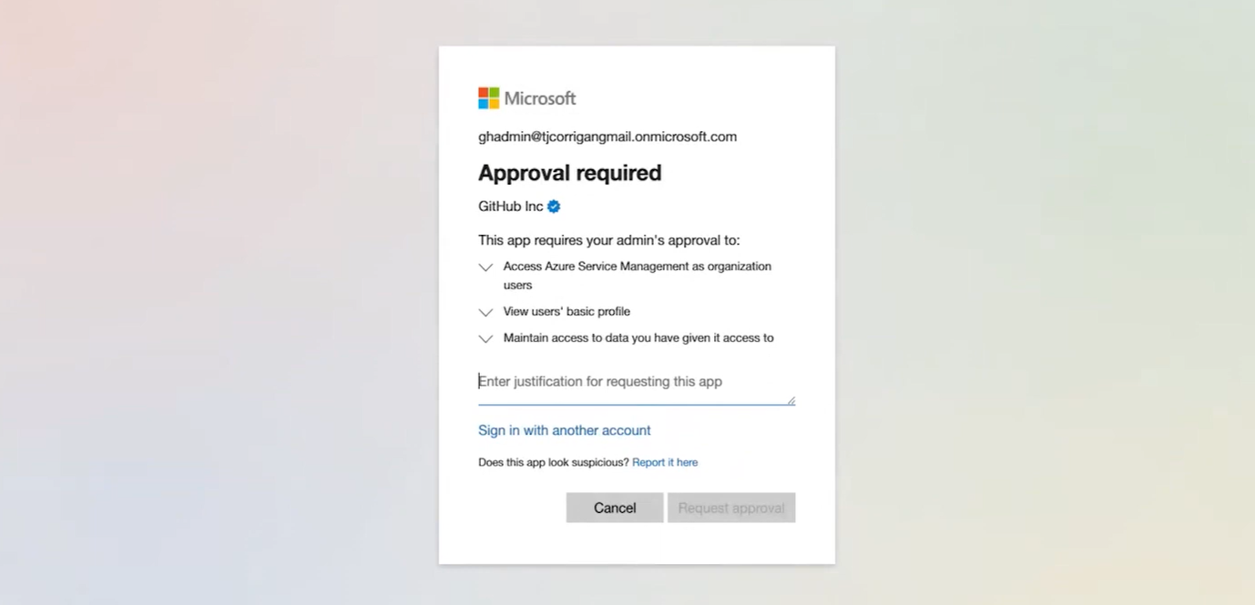
Enable Billing with Azure Subscription
Approval required may pop up if the user is not have required permission

Slide 16
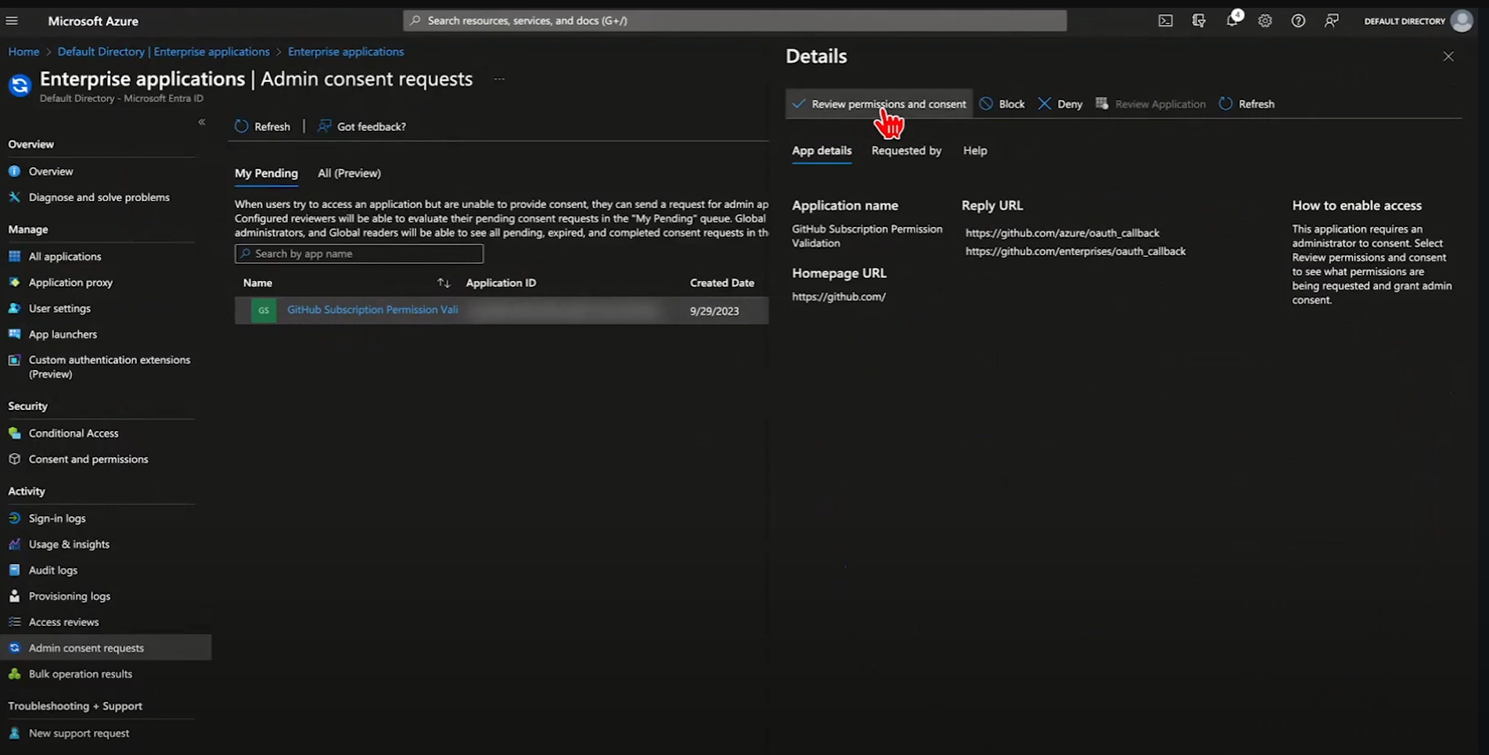
Enable Billing with Azure Subscription
Metered billing Demo | GitHub Enterprise and GitHub Advanced Security - YouTube
Admin consent the request

Slide 17
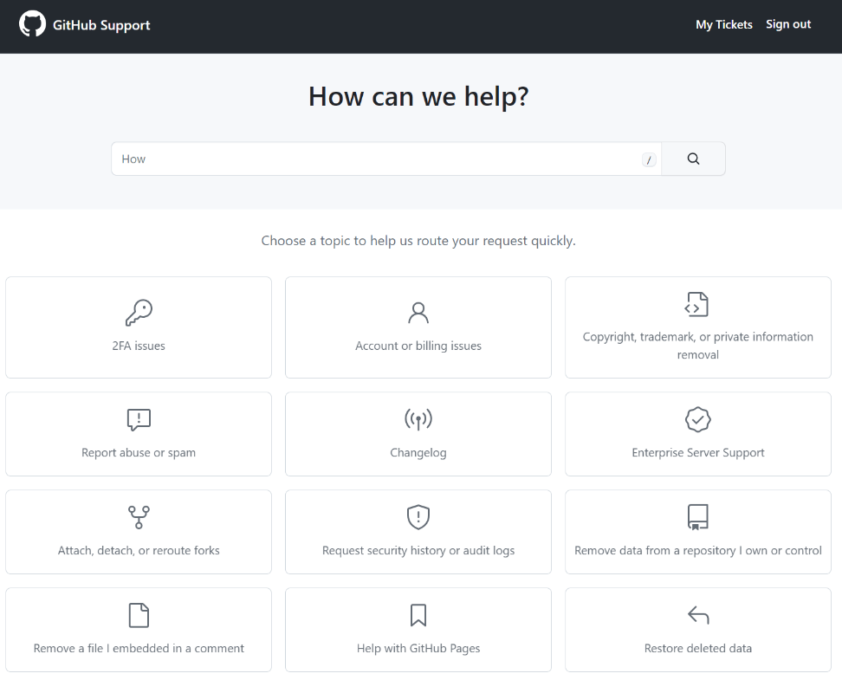
Support
Microsoft CSP partners will be responsible for providing Tier 1 support
Billing
Azure Billing Support
Technical
From 1 Aug, Microsoft CSPs will need to open a support ticket directly with GitHub at
https://support.github.com/contact?tags=partner-microsoft-csp
Over time, there will be integration within the Azure Portal experience for partners to open tickets natively.
Creating an enterprise account as a Microsoft CSP partner - GitHub Enterprise Cloud Docs

Slide 18


Azure + Github logos

Slide 19


Azure & GitHub: Better Together
Boost developer productivity
Most loved development environments
AI powered pair programming
Manage effectively
Streamline deployment
Unified cloud management
DevOps platform and AI tools
Enterprise-grade app platform
Enterprise-grade CI/CD automation
Secure across the stack
Cloud-native enterprise application protection
Proven application security testing
*Now in private preview

Slide 20








Develop apps securely with a unified solution
Dev
Visual Studio Code
Azure Repos
Azure Pipelines
GitHub Advanced Security
Container Scanning
Code scanning
Secret scanning
Dependency review
GitHub Repos
GitHub Actions
Azure Container Registry
Azure
Codespaces
IaC Scanning
Microsoft Defender for Cloud
Defender for DevOps
DevOps Security Mgmt.
GitHub & Azure DevOps Connectors
Code to Cloud Context
SecOps
Cloud Security
Posture Management
Threat Protection
Secure Azure Policy
Azure Secure Score
Azure Security Benchmark
WAF / DDoS
Microsoft Sentinel
Azure
AD
App Config
Azure Monitor
Azure Key Vault

Slide 21
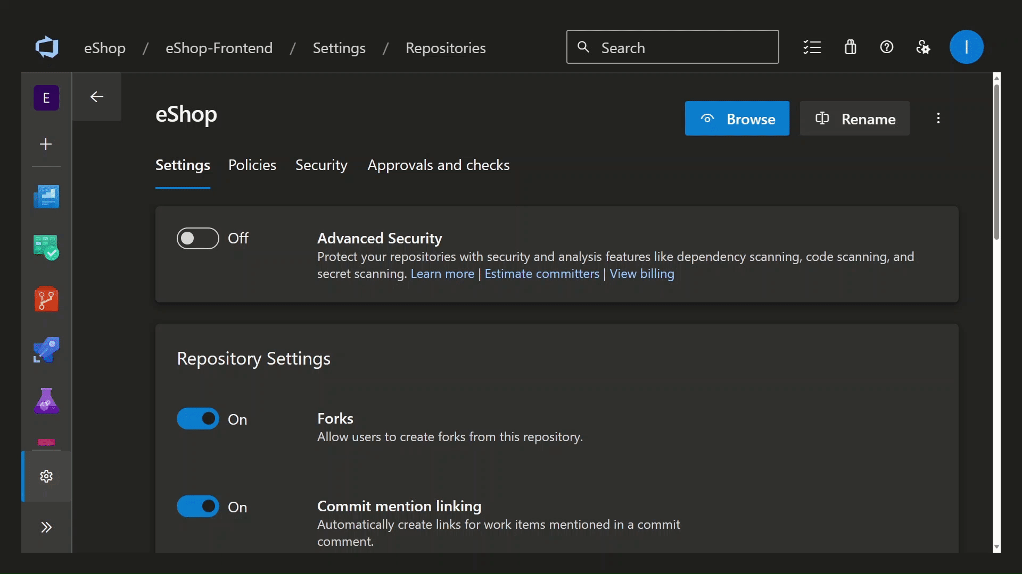
GitHub Advanced Security for Azure DevOps
Suite of security testing tools native to the Azure DevOps platform
Secret scanning to find any exposed secrets in your Azure Repos and prevent new secrets from shipping in your code
Dependency scanning to detect vulnerable open-source components and offer straightforward remediation guidance
Code scanning for powerful static analysis that helps you find and fix vulnerabilities in your code as you write it

Slide 22
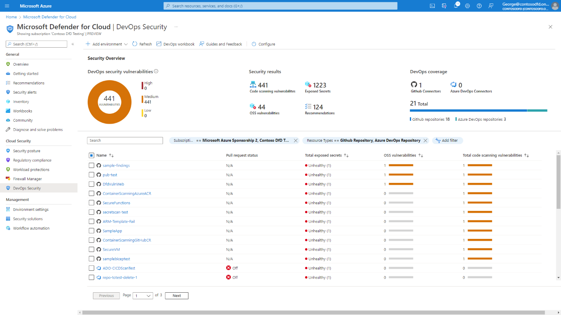
Defender for Cloud DevOps Security
Defender for DevOps empowers security teams with unified DevOps security management across multipipeline and multi-cloud environments, with:
Unified visibility into DevOps security posture
Strengthened cloud resource configurations
Automated and integrated security intelligence
Microsoft Defender for Cloud DevOps security - the benefits and features - Microsoft Defender for Cloud | Microsoft Learn

Slide 23
Accelerating Software Development
Key requirements for success
Unleash creativity with the power of AI
Developers
Increased productivity
Increased focus
Increased energy
Embed AI throughout the development process
Managers
Increased developer satisfaction
Accelerated innovation
Bridged skill gaps
Securely train AI on your organization’s data

Slide 24







Better Together
Boost developer productivity
AI-powered development
Developer tools
The world’s most widely adopted AI developer tool
Solutions that accelerate developer productivity
Get AI-based suggestions in real time
Enterprise ready scalability and flexibility
Experience docs that feel tailored for you
AI pair programming
Most loved development environments
One-stop developing environments
Enable greater collaboration
Ready-to-code and on-demand
Improve code quality and security
Centralized governance and security

Slide 25




Accelerate development
Visual Studio Family
Azure Developer CLI
QuickStart Templates
GitHub Codespaces
Microsoft Dev Box
GitHub Copilot
Proven to increase developer productivity and accelerate
the pace of
software development
Equip developers with the IDEs they love for quick, efficient and collaborative development
Boost development with secure cloud workstations built for developer productivity

Slide 26





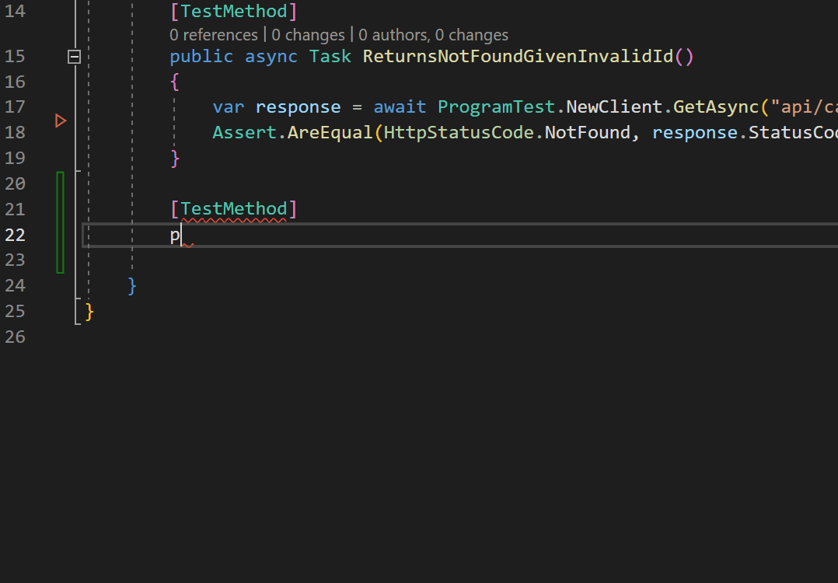
Visual Studio + GitHub
Seamless integration
Authenticate your GitHub.com or GitHub enterprise account to manage your repository directly from Visual Studio
Built-in intelligence
Supercharge your productivity in Visual Studio and Visual Studio Code with GitHub Copilot and Copilot chat
Streamlined workflows
Create, merge, and rebase branches directly from Visual Studio, and automatically catch merge conflicts when they occur

Slide 27
Streamlining deployment
Key requirements for success
Automate manual tasks
Developers
Decreased time spent on repetitive tasks
Streamlined testing
Standardize deployment
Scale your DevOps practices
Managers
Increased collaboration
Eliminating silos and increasing consistency
Higher developer satisfaction
Leverage inner source throughout your organization

Slide 28







Better Together
Streamline deployment
Automation
Infrastructure
Automate every part of CI/CD
Build and deploy any app
Automate workflows
Global scale
Shift security, compliance and governance left
Enterprise-grade CI/CD automation
Enterprise-grade app platform
Enterprise grade
Accelerate developer velocity
Innovate with AI
Native integrations with Azure
Developer-centric

Slide 29


Deploy modern apps seamlessly
Azure
Azure AI Azure Deployment Environments
GitHub Actions
GitHub Actions for Azure
GitHub Copilot for Azure
GitHub Models
Automate everything and accelerate deployment with enterprise-grade CI/CD and context-aware AI assistance
Enable your developers to focus on app innovation, not infrastructure, with the latest AI advancements

Slide 30

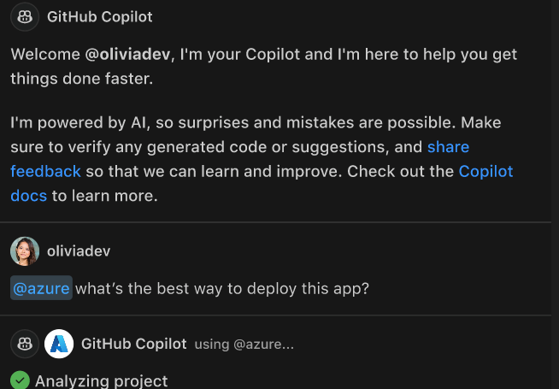



GitHub Copilot for Azure
Private Preview
Use Copilot Chat in a development tool to
Learn about Azure resources and best practices
Explore and manage Azure resources
Troubleshoot and optimize apps on Azure quickly and easily
Join the preview aka.ms/azcode/copilot/preview-signup

Slide 31

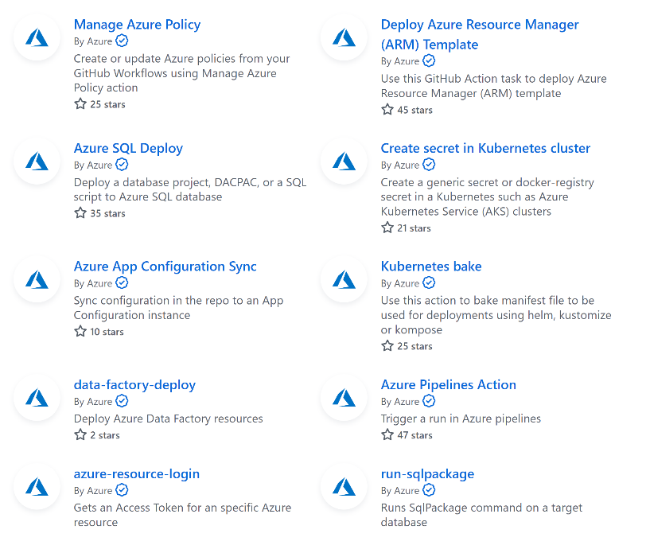


Azure-specific actions and workflows
GitHub Actions for Azure
A foundation for reusable templates and workflows

Slide 32


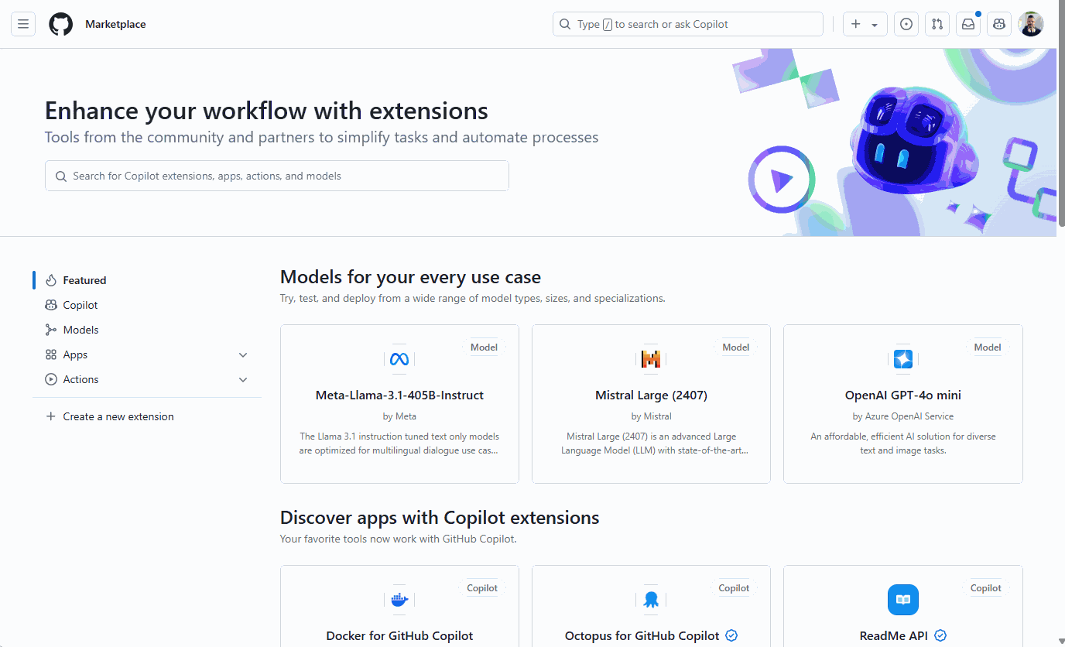
+
Empowering GitHub Developers to Build with AI
Get access to a curated list of our top AI models, without leaving GitHub
Mix, match, and experiment with models in the GitHub playground for free*
Unlock the full capabilities of the latest models with Azure
Read more in Thomas’ and Asha’s blogs
Discover in GitHub Models
https://github.com/marketplace/models
*Usage limits apply

Slide 33
Where can Microsoft partners go to train and upskill on GitHub
Future or on-demand trainings:
Sales: https://aka.ms/GitHubSalesSkilling
Technical: https://aka.ms/GitHubTechSkilling
GitHub Technical bootcamp (on-demand): here
Getting Certified on GitHub:
GitHub certifications:
Resources: https://resources.github.com/learn/certifications/
Learning paths: https://learn.microsoft.com/training/github/
Cloud week for certifications: https://aka.ms/partner/cloudweek
More advance, earning the specialization for DevOps with GitHub on Azure: https://partner.microsoft.com/partnership/specialization/devops-with-github

Slide 34
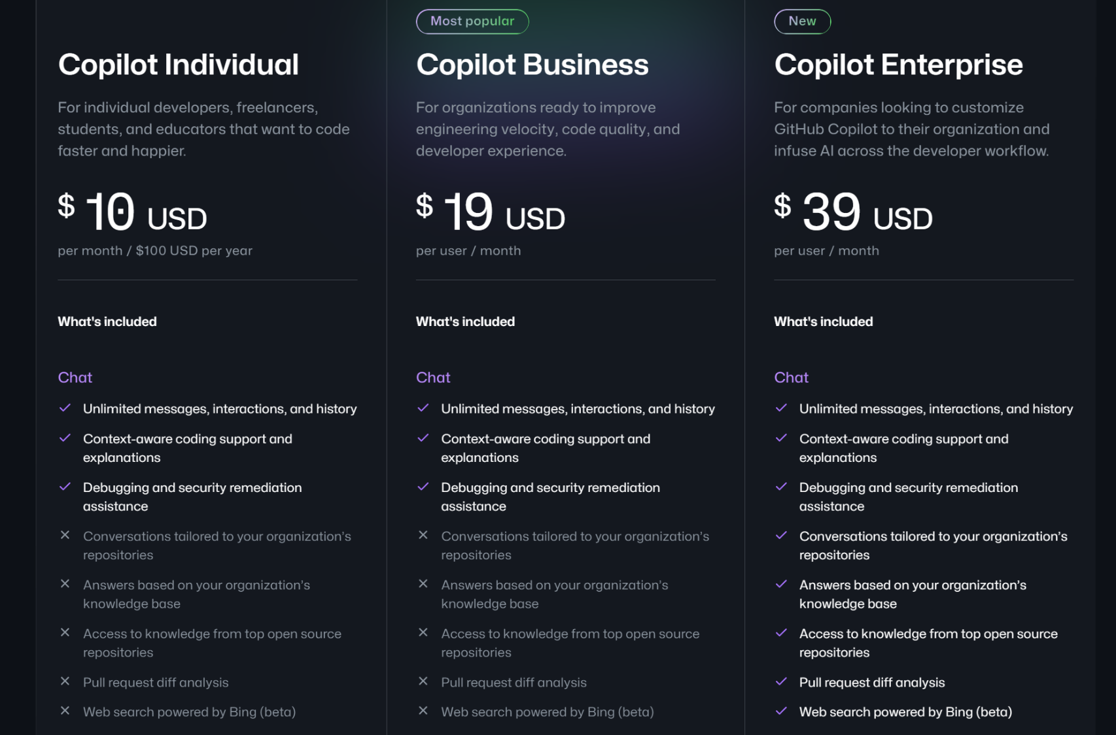

Slide 35
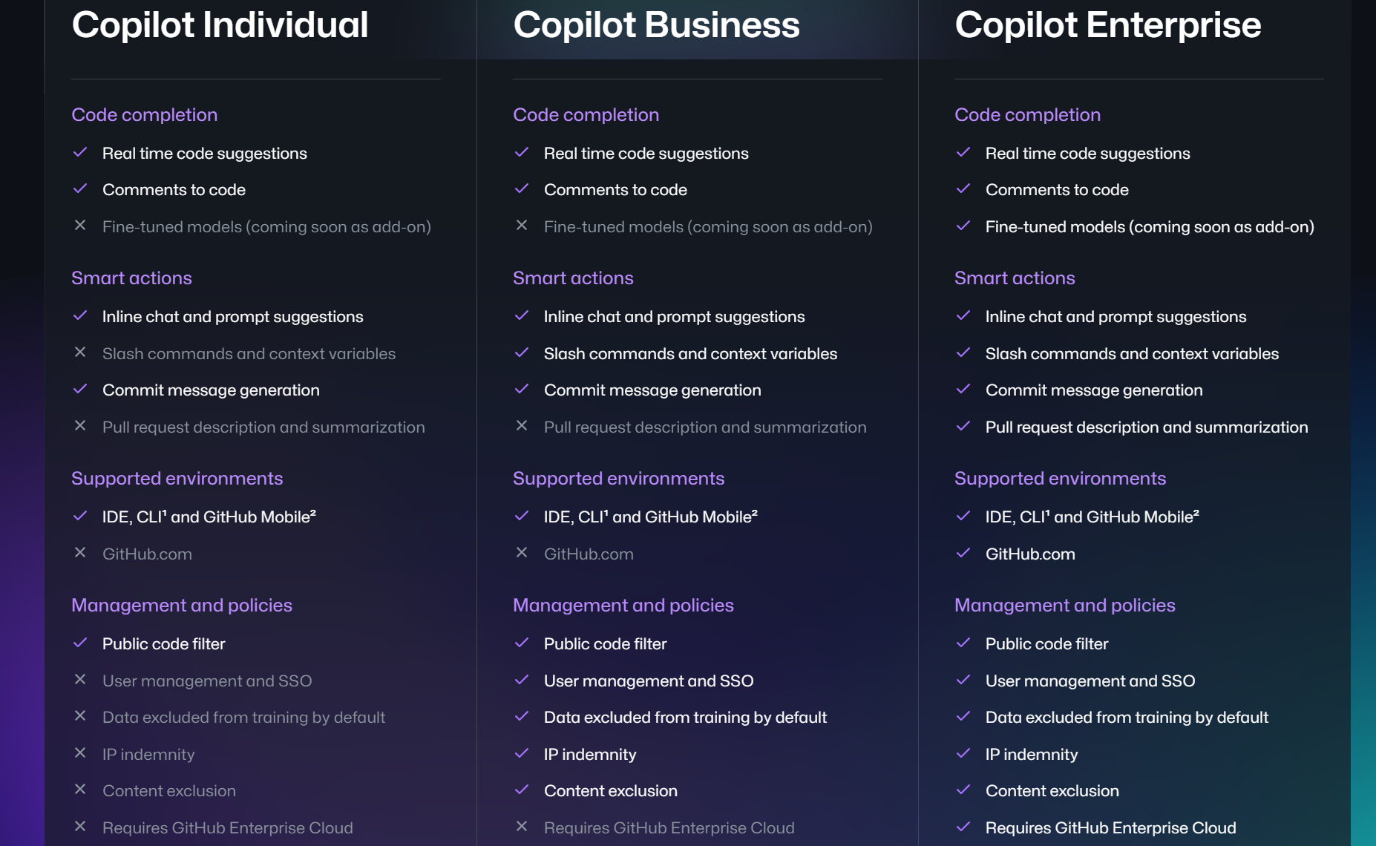

Slide 36



The Total Economic Impact of Microsoft Developer Tools
92%
66%
562% ROI
within three years
Reduction in time to remediate
Decrease in time-to-market
Visual Studio, GitHub Enterprise, Azure
“We used to do monthly deployments or updates. Now, we’re doing one sprint every two weeks for the apps that we need to push through.”
— Operations Analyst, Composite Organization
30%
20%
Increase in developer productivity
Reduction in critical application downtime
Sources: The Total Economic Impact of GitHub Enterprise Cloud and Advanced Security, Nov 2022 | The Total Economic Impact of Microsoft Developer Tools and Cloud Services, Oct 2021

Slide 37


Case study
General Motors reimagines the developer toolchain and experience with Microsoft tools
“To innovate faster and introduce new capabilities that connect people to things that matter, you have to collaborate with a company that thinks with a developer mindset. That’s what made Microsoft developer platform a really good choice for us”
— Michael Anderson, Director, GM Global IT
See the full customer story

Slide 38


Case study
EY
scales GenAI for enterprise with Microsoft Azure AI
“In collaboration with Microsoft, we’ve crafted a powerful cloud cost-optimization framework on our technology acceleration platform GTP-FS. It’s helped us achieve swift client onboarding, autoscale the GTP-FS platform, and meet tight time-to-market objectives”
— Nate Hanafy, FSO Tax CTO Partner, Ernst and Young LLP United States
See the full customer story

Slide 39

Case study
ESW
embraces innovation and more efficient coding with GitHub Copilot
“By adopting GitHub Copilot, we’ve been able to embrace AI quicker than ever, while helping our people feel more empowered, productive – and ultimately more fulfilled”
— Bruno Quintella, Director of Engineering, ESW
See the full customer story

